Slide 1
Gaussian Blur vs bilateral Filter
DUONG VAN GIANG
07/01/2024
WEEK 4
Blur image with gaussian blur –sigma1
Blur image with bilateral filter same sigma1 in both space sigma and coloR sigma
Try with different sigma
Compare gaussian vs bilateral kernel in edge regions
Date | Topics | Related topic
06/10/2024 – 06/14/2024 06/17/2024 – 06/19/2024 | Erosion, Dilation, Opening, Closing, Back-Hat, White-Hat, HitOrMiss | Morphological Processing
06/20/2024 - 06/21/2024 06/24/2024 – 06/28/2024 | Box Filter, Gaussian Blur, Median filter, Bilateral Filter, Histogram Equalization | Intensity Transformations
07/01/2024 - now | Bilateral Filter

Slide 2
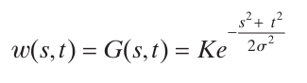
Gaussian blur – normal distribution
G(s, t): value of the function in the point(s,t)
K: This is a normalization constant that ensures the sum of all weights in the kernel is equal to 1.
e: 2.71828
s and t: coordinate of the point in the kernel base on the center
σ: The deviation of the Gaussian distribution
Gaussian blur:

Slide 3
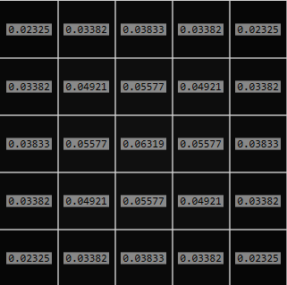
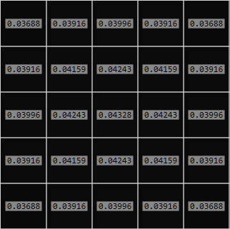
Gaussian blur – normal distribution
Apply the function:
- kernel size 5 x 5
- sigma = 2
Apply the function:
- kernel size 5 x 5
- sigma = 5

Slide 4
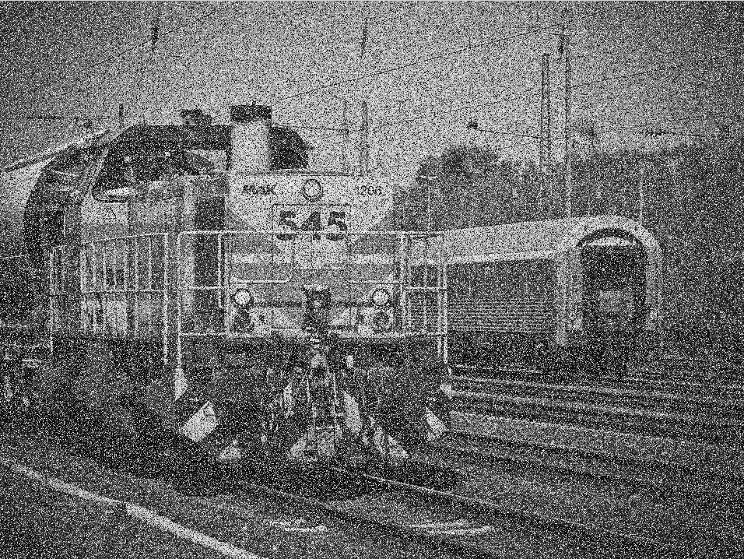

Gaussian blur – normal distribution

Slide 5
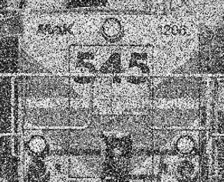
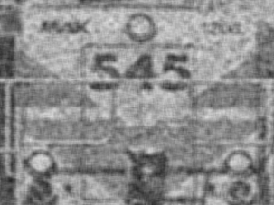

Slide 6
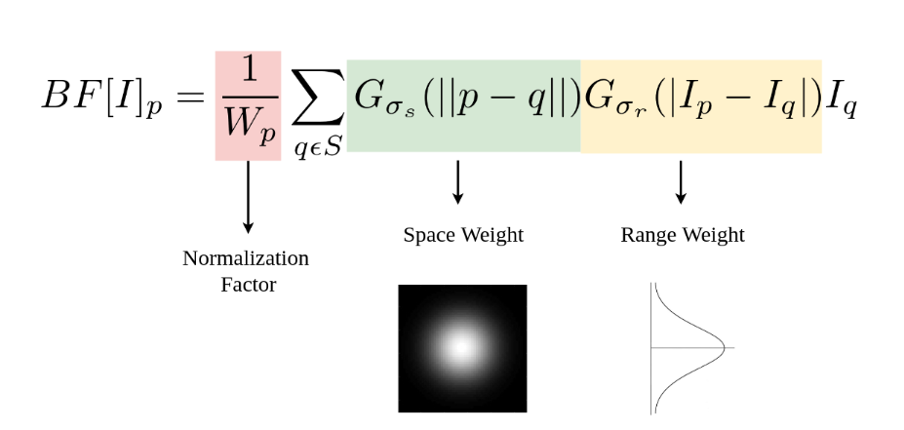
Bilaterial fillter
Gaussian filter only care about the weight of space around the kernel. So sometime the edge of the object become blurry. On demand of making the edge more standout we need to care about the range of the intensity in the neighbor area. So this is the reason Bilaterial fillter exist

Slide 7

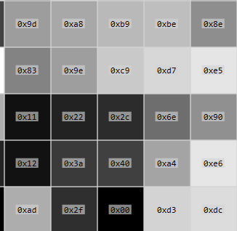
Bilateral filter
Let study about the red area

Slide 8
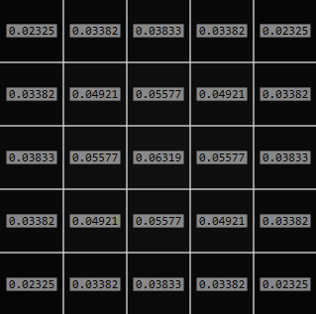
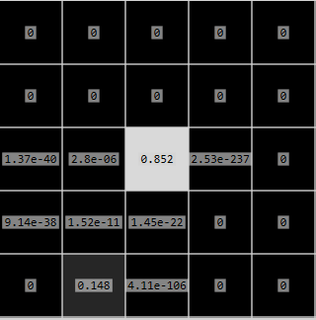
Bilateral filter
Let compare the kernel of gaussian blur and bilateral blur in same sapcesigma=2, color sigma = 2 and
kernel size: 5 x 5
Gausian filter
Bilateral filter

Slide 9
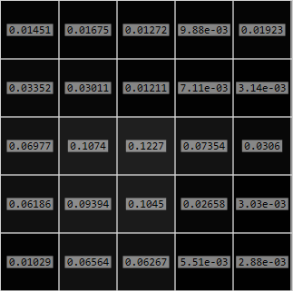
Bilateral filter
For comparing the kernel, let’s make the colorsigma = 75 and spaceSigma = 2.
Gausian filter
Bilateral filter

Slide 10


Bilateral filter
Comapring result of gaussian filter vs bilateral filter
Gaussian filter output(sigma_s=2)
Bilateral filter output( sigma_s=2, sig_r=75)
Both picture reduced noices. But the edge of the output in bilateral filter is way more clear.

Slide 11


Bilateral filter – compare
MyImplementation | Opencv
4933.56ms | 5.2389ms
opencv
My implementation

Slide 12
Reduce processing time of my bilateral filter
Tip: sigma_s => Look up table
sigma_r => Pre-calculated table of exp(i1-i2)
Show some of intensity kernels as in different regions such as edge region and plain area.
Show the space kernel too for comparison
Review your program to show the effects of gaussian filtered and bilaterial filtered outputs.

